Slide 1
Acoustic levitation using a TinyLev acoustic levitator
Progress Report 2
Dalton Ludington
Daniel Opdahl

Slide 2
Goal
To determine what the largest specific weight of an object of set volume that can be levitated is?
Notes:
The definition of specific weight is an object’s weight on Earth per unit volume of material
Our Testable research question™ is “What is the largest specific weight of an object of set volume that can be levitated?”

Slide 3
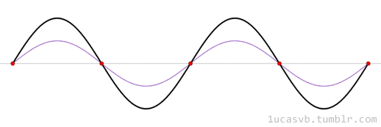
Standing wave review
1ucasvb’s lab. “Standing waves (aka stationary waves)” 19 Mar 2013, 20:40, https://1ucasvb.tumblr.com/post/45792819532/standing-waves-aka-stationary-waves-standing#notes
Notes:
Wave is made of high and low pressure that travels through air.
Areas of pressure correspond to displacement of air molecules from original position
2 waves can combine to constructively or destructively interfere
Standing waves are the real kicker for our theory
2 waves, red and blue, combine to the solid black wave
Note how in a standing wave the location of peak displacements don’t move through space
Red dots are nodes, and in between the red dots are antinodes
Nodes = low displacement, high pressure
Antinodes =oscillate between high and low pressure

Slide 4
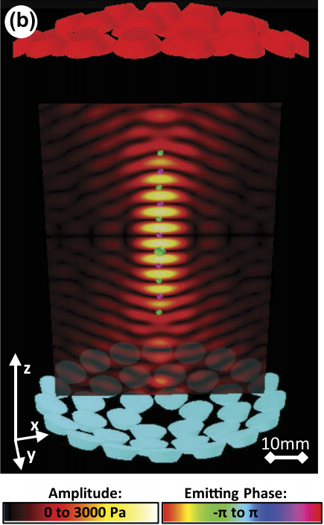
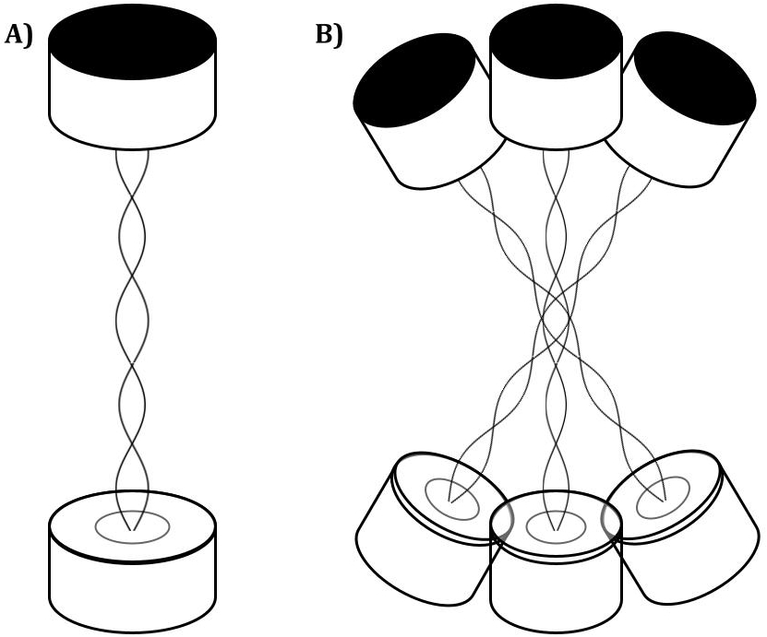
Acoustic levitation
TinyLev: A multi-emitter single-axis acoustic levitator. Asier Marzo, August 10, 2017. https://aip.scitation.org/doi/pdf/10.1063/1.4989995
Notes:
We place transducers in opposing pairs that create standing waves, as in A
If many pairs of opposing transistors are arranged in a crescent or bowl shape, the center nodes created by each standing wave are all superimposed on one another.
This creates a focused central node, formed by the combination of all of the standing waves, as well as several nodes above and below the central node.
This is a more realistic model of the diagram before
Opposing transistors arranged in bowl shapes create many standing waves that combine to create several nodes (dark bands corresponding to small amplitudes) and antinodes (bright bands corresponding to large amplitudes). Objects (green and purple spheres) can be levitated in the nodes of the standing waves.

Slide 5
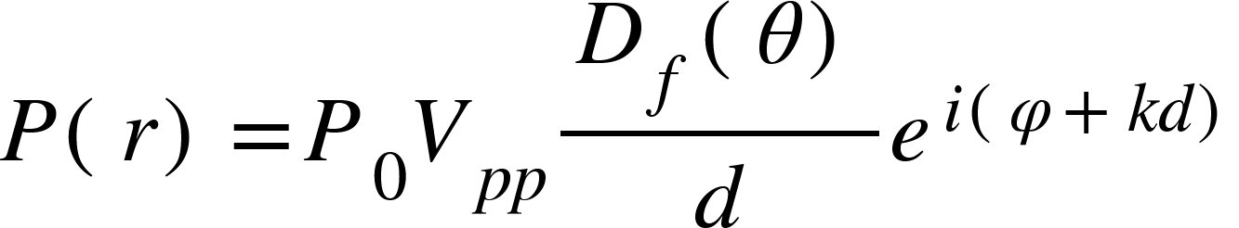
Determining the Pressure
Far-field directivity function
Locating vector
Amplitude constant
Propagation distance
Wavenumber
Peak-to-peak amplitude
Emitting phase of source
TinyLev: A multi-emitter single-axis acoustic levitator (Additional Resources). Asier Marzo, August 10, 2017. https://aip.scitation.org/doi/pdf/10.1063/1.4989995
Notes:
In order to determine the largest specific weight of leviated object, we will be working with a model that relates the pressure to the force
For our purposes, at least initially, we want to focus on the central node for simplicity.
The equation above gives the pressure as a function of a locating vector r for a single transducer
This equation incorporates the voltage applied to the transducers, etc.
D(0) can be modeled as sinc = sinx/x

Slide 6
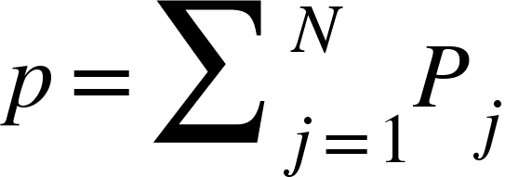
Summing the Pressures
Number of individual transducers (for us, N=72)
Total acoustic field
Individual acoustic field
TinyLev: A multi-emitter single-axis acoustic levitator (Additional Resources). Asier Marzo, August 10, 2017. https://aip.scitation.org/doi/pdf/10.1063/1.4989995
Notes:
We will get the total acoustic field generated by all the transducers by simply summing the individual fields

Slide 7
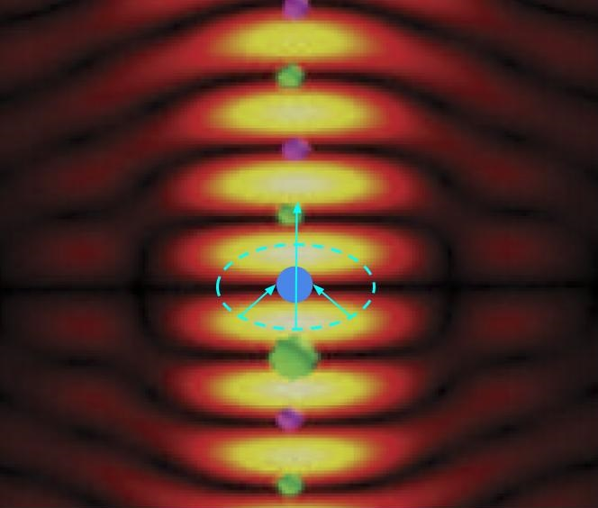

Determining the Force
Force
Gork’ov potential
TinyLev: A multi-emitter single-axis acoustic levitator. Asier Marzo, August 10, 2017. https://aip.scitation.org/doi/pdf/10.1063/1.4989995
Notes:
Gorkov potential
In 1961, L.P Gor’kov derived the lowest order force on a spherical particle in an acoustic field.

Slide 8
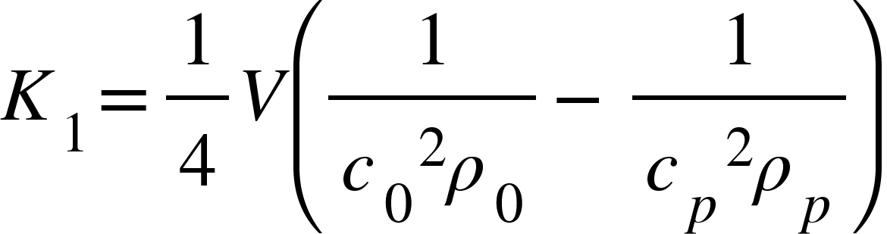
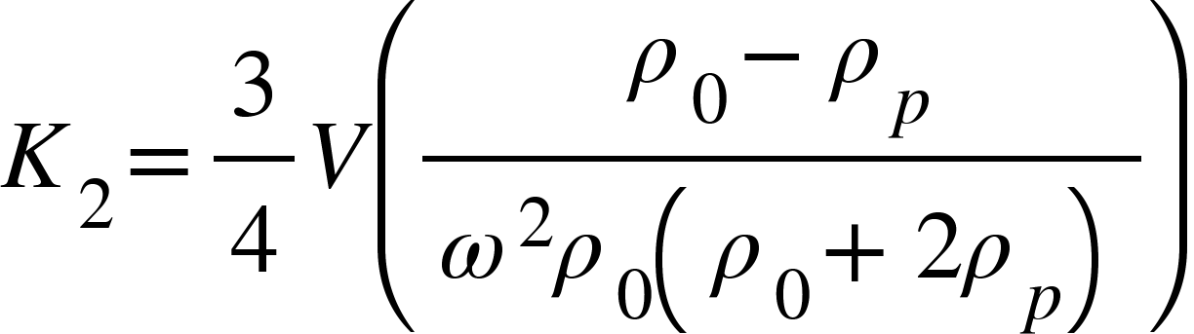
Gork’ov Potential
TinyLev: A multi-emitter single-axis acoustic levitator (Additional Resources). Asier Marzo, August 10, 2017. https://aip.scitation.org/doi/pdf/10.1063/1.4989995
Complex pressure
Partial derivatives of complex pressure
Volume of levitated particle
Speed of sound through levitated particle
Speed of sound in air
Density of air
Density of particle
Notes:
We are writing matlab code to calculate these
We think that this is appropriate to answer our question because it allows us to calculate and model a complex pressure field from just the voltage applied, and a few constants that depend on our particular set up (transducers, air, etc.) and from that pressure field, we can get our force, which will allow us to say what the largest specific weight of a set volume we can levitate.

Slide 9
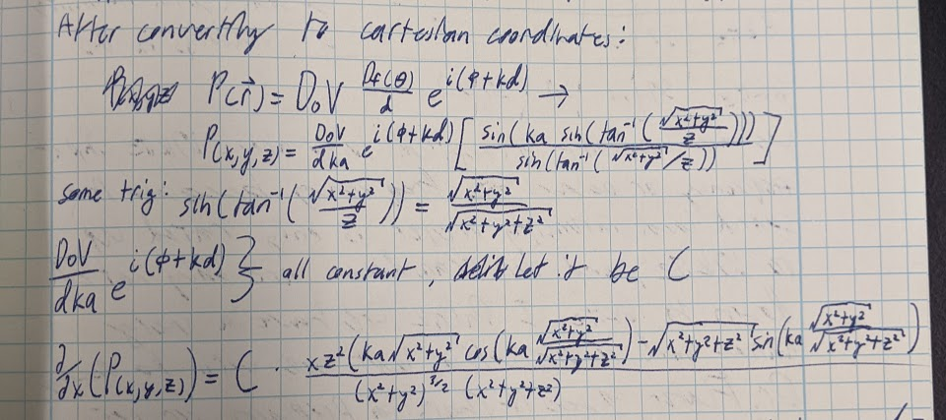
Taking the partial derivatives

Slide 10
Why This Model?
Notes:
This model is appropriate because it allows us to find how much levitating force is being exerted on an object. When that levitating force and the gravitational force balance, we can find the largest specific weight of a levitating object.

Slide 11
MATLAB analysis
Finding the complex pressure
Taking the partial derivatives of complex pressure
Calculating the Gork’ov potential
Taking the gradient to get the force
Most calculations done by hand, then put in script

Slide 12
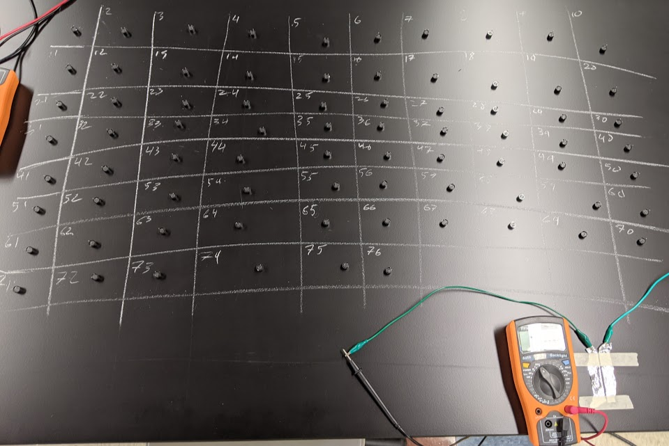
Transducer testing

Slide 13
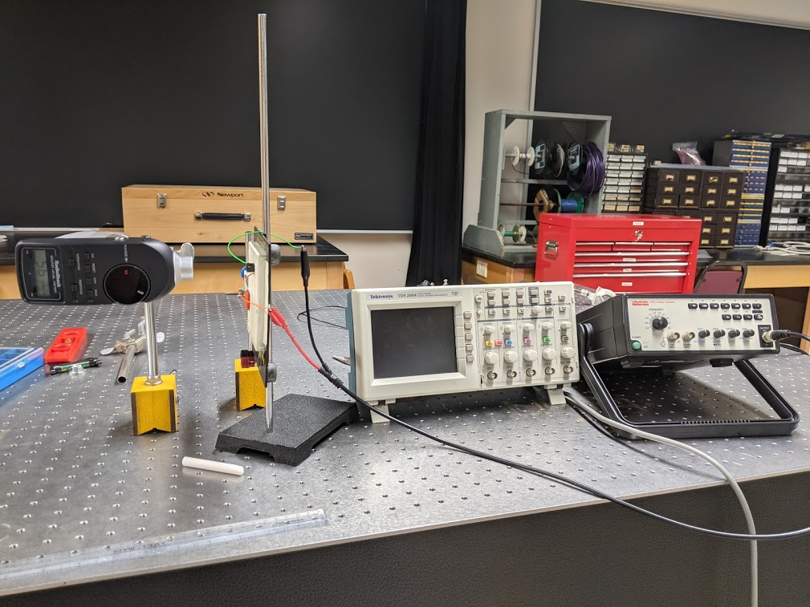
Transducer testing

Slide 14
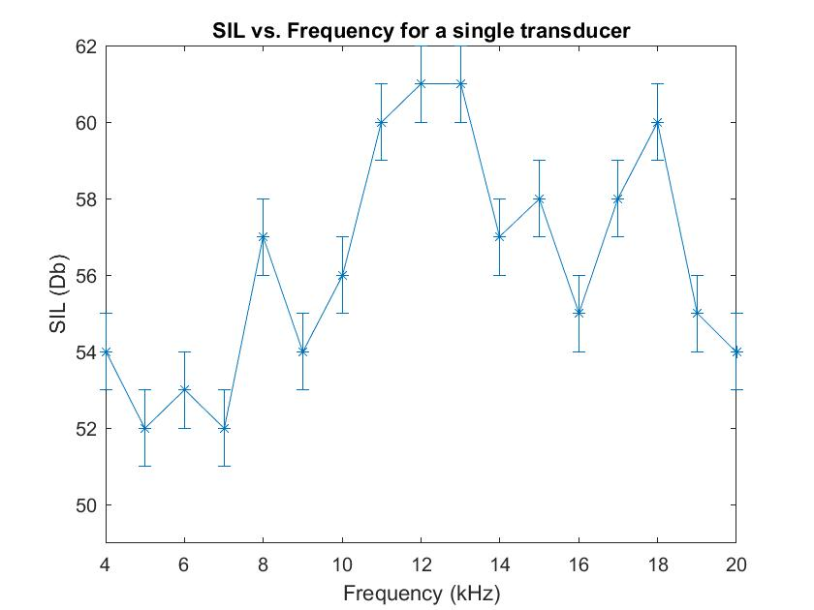
Assumption testing

Slide 15
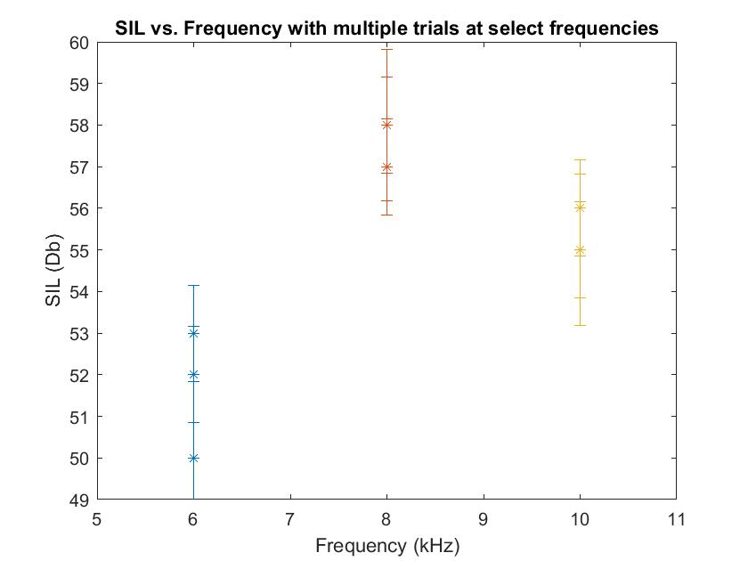
Assumption testing

Slide 16
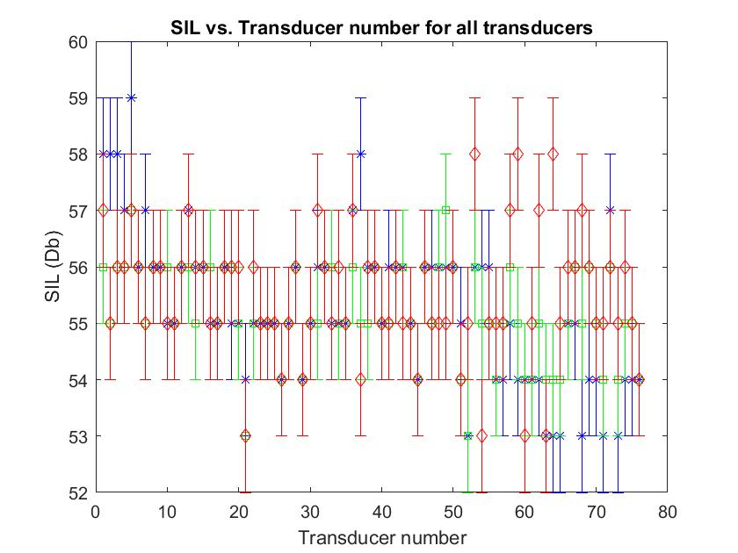
Transducer testing

Slide 17
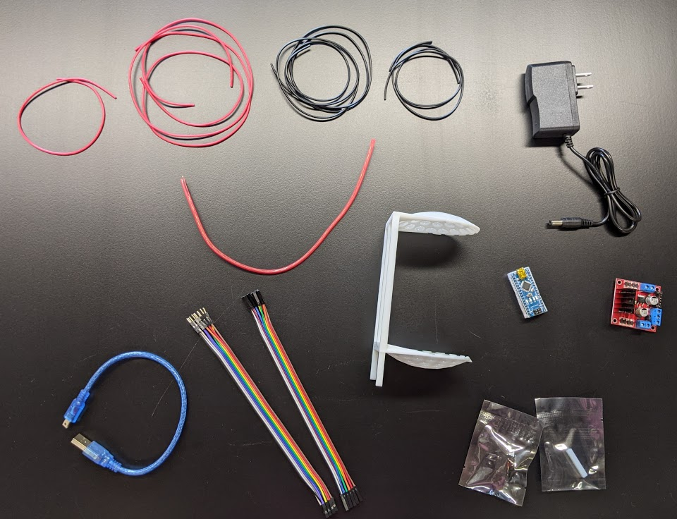
Levitator components

Slide 18
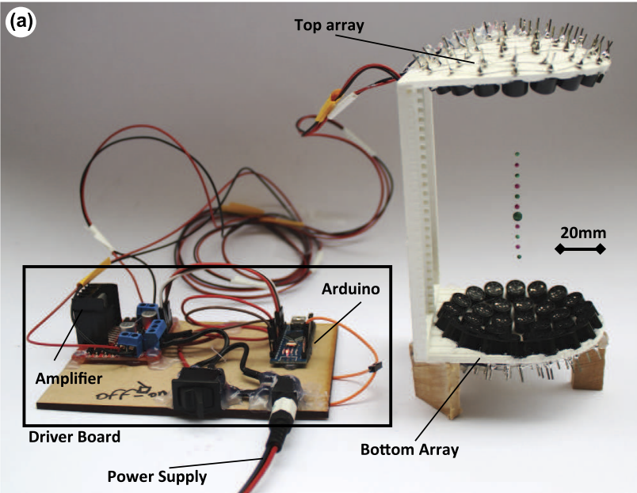
Whole levitator apparatus
TinyLev: A multi-emitter single-axis acoustic levitator. Asier Marzo, August 10, 2017. https://aip.scitation.org/doi/pdf/10.1063/1.4989995

Slide 19
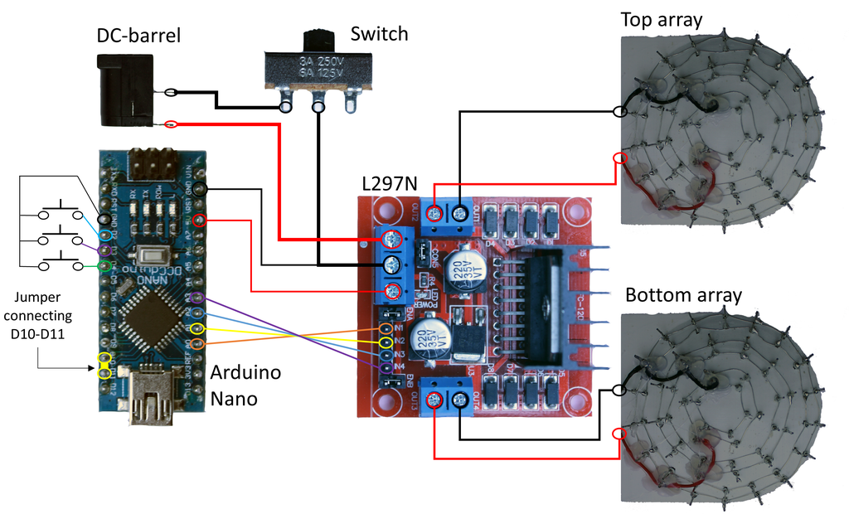
Levitator apparatus schematic
Acoustic Levitator. UpnaLab. Instructables. August 14, 2017. https://www.instructables.com/Acoustic-Levitator/
Notes:
Daniel: Talk about how the apparatus will help us to determine the specific weight of a levitating object

Slide 20
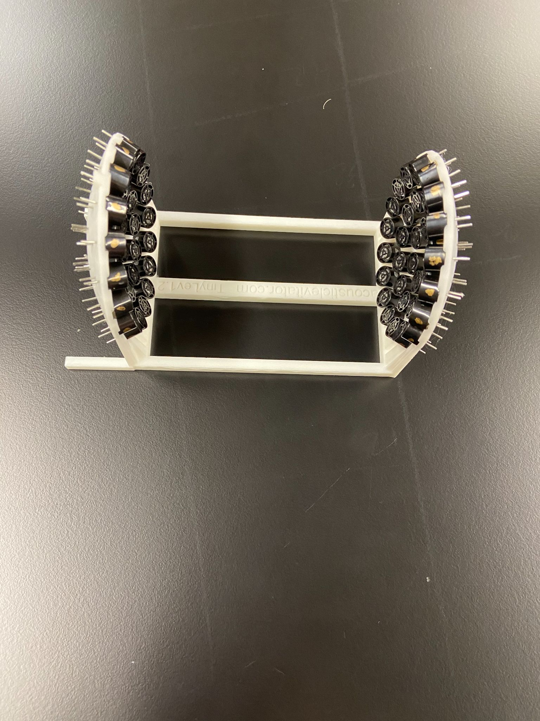
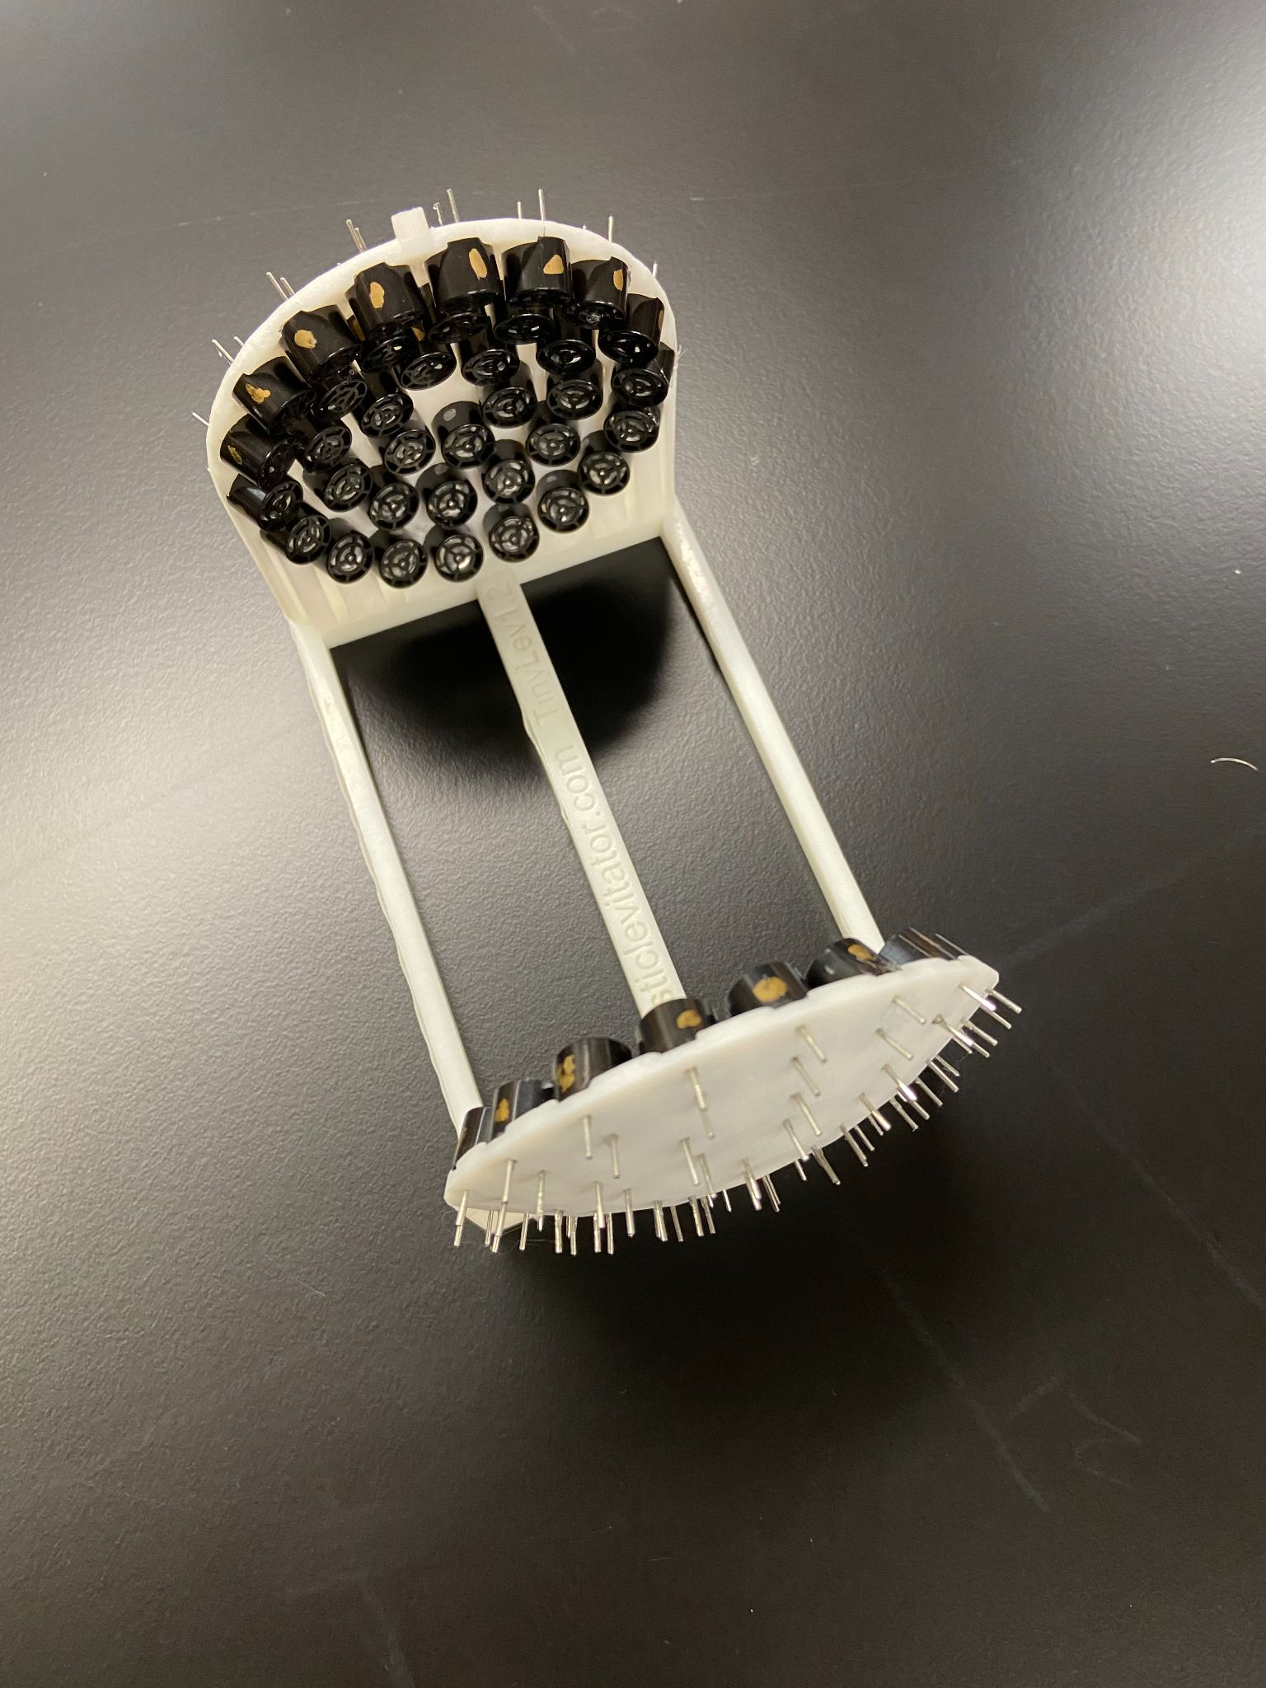
Construction so far

Slide 21
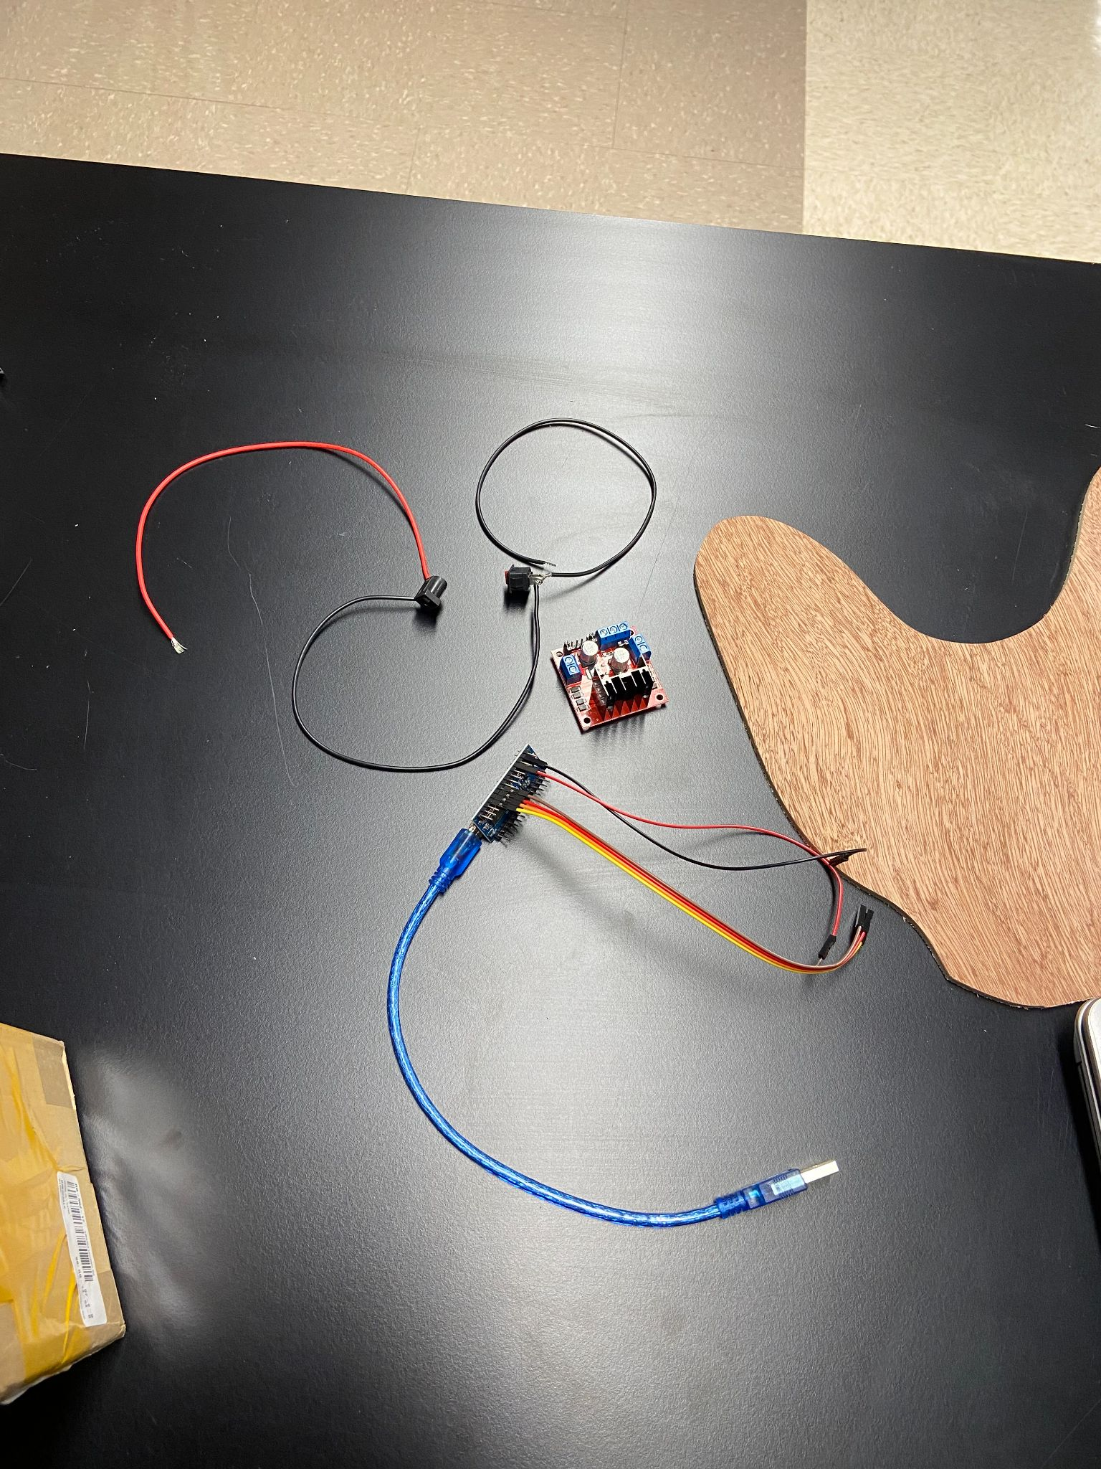
Construction so far

Slide 22
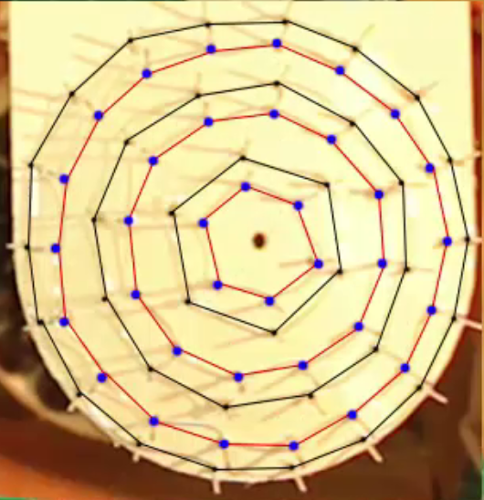
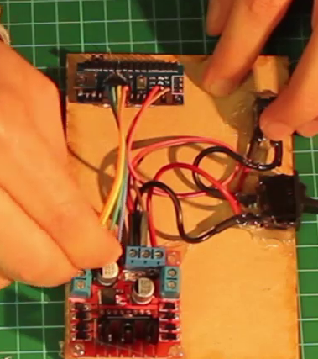
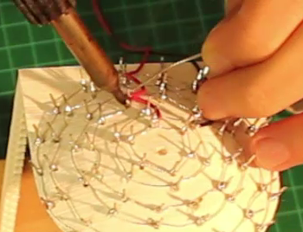
Next steps in construction
Acoustic Levitator. UpnaLab. Instructables. August 14, 2017. https://www.instructables.com/Acoustic-Levitator/

Slide 23
Challenges
Past
Only testing transducers when it is quiet in the lab
Testing polarity of transducers
Taking the partial derivatives
Future
Soldering the thin wires that connect transducers carefully
Taking the gradient of the Gork’ov potential

Slide 24
Summary
Goal: To determine what is the largest specific weight of an object of set volume that can be levitated?
Standing wave and acoustic levitation review
Determining the force using the complex pressure and Gork’ov potential
How we are building a MATLAB script to model levitation
Transducer testing: necessity, setup, assumptions
Testing our assumption about the transducers
How we’re building
Challenge with transducers, mathematics, and soldering

Slide 25
Questions?

